Slide 1
Metastable, amorphous and quasicrystalline phases in explosively welded materials
I.A. Bataev, V.I. Mali, K. Hokamoto, H. Keno, M.A. Esikov, A.A. Bataev, A.V. Vinogradov and I.A. Balagansky
1. Novosibirsk State Technical University, Novosibirsk, Russia
2. Lavrent'ev Institute of Hydrodynamics, Siberian Branch, Russian Academy of Sciences, Novosibirsk, Russia
3. Shock Wave and Condensed Matter Research Center, Kumamoto University, Kumamoto , Japan

Slide 2
Outline
1. “Classical” ways to vetrification of metals and alloys
2. Amorphization of metal at explosive welding of Ti and Al
3. Amorphization of metals at explosive welding of Nb and stainles steel
4. Formation of quasicristals at explosive welding of Ni and Al
5. Conclusions

Slide 3
1. “Classical” ways to vetrification of metals and alloys
1. Physical vapor deposition (i.e. magnetron sputtering)
2. Strain-induced amorphization (i.e. during mechanical alloying)
3. Rapid solidification of liquid phase.
“…non-crystalline structures can be obtained for some, perhaps all, metals and alloys by quenching rapidly enough from the molten state”. W. Klement, R.H. Willens. P. Duwez. Nature 187(1960)

Slide 4
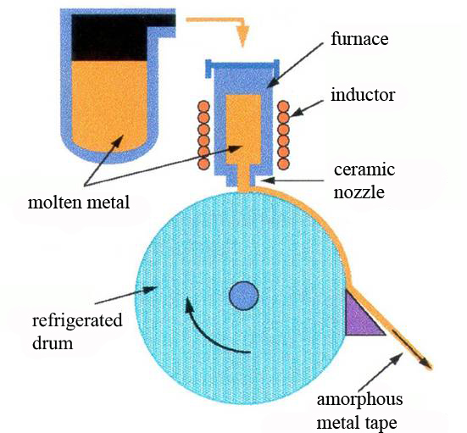
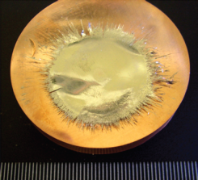
Rapid solidification of metals
Splat quenching
Melt spinning

Slide 5
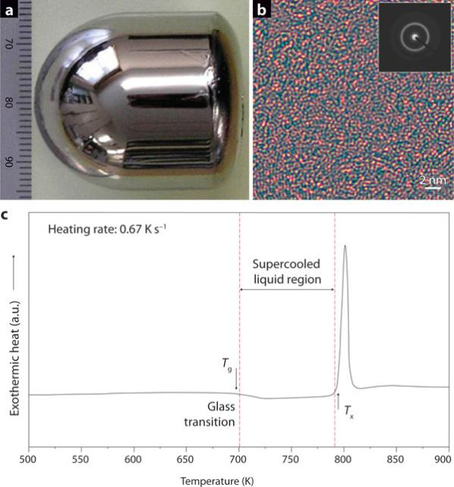
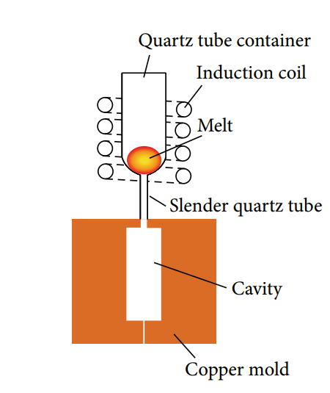
Bulk metallic glasses
Copper mold casting
Zr_{41.2}Ti_{13.8}Cu_{12.5}Ni_{10.0}Be_{22.5} – Vitreloy 1
Critical diameter is around 10 cm!!!

Slide 6
Selection of amorphizable alloys composition
The empirical rules of Inoue*:
- multicomponent systems consisting of more than three elements;
- significant difference in atomic size ratios above about 12% among the three main constituent elements;
negative heats of mixing among the three main constituent elements;
most of the known glassy alloys compositions are located near deep eutectics
* Acta mater. 48 (2000) 279±306

Slide 7
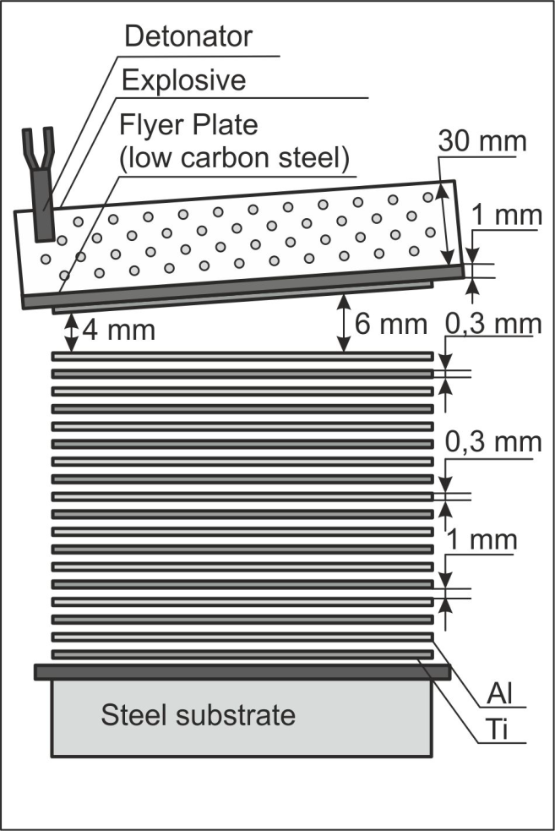
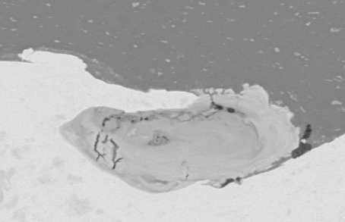
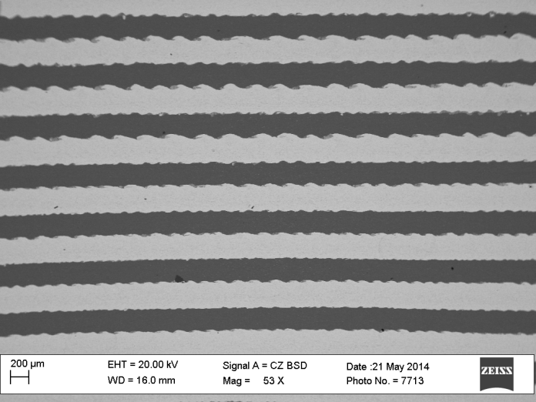
2. Amorphization at welding of cpTi and Al-1%Mn
Typical composition of the vortex zone (wt %)
Ti | 35
Si | 0.2
Mn | 0.5
Al | Rest

Slide 8
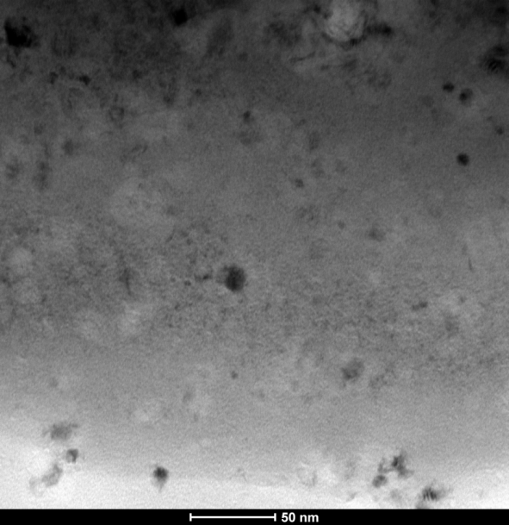
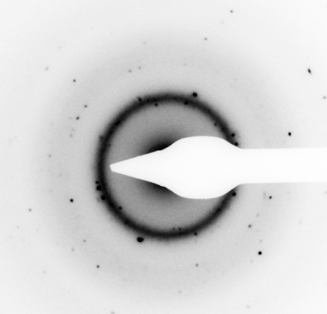
2. Amorphization at welding of Ti and Al

Slide 9
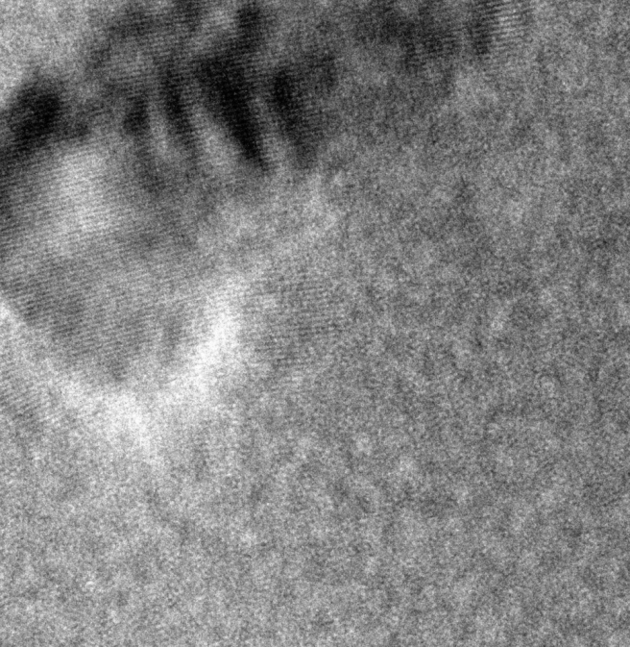

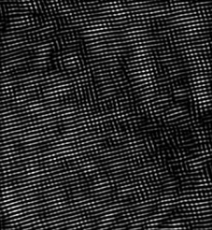
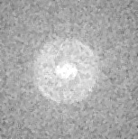
HRTEM of partially crystalline zone
FFT
Filtered FFT
Original image

Slide 10

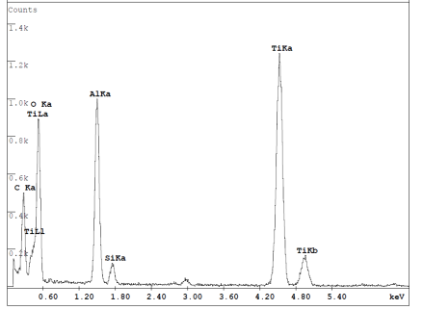
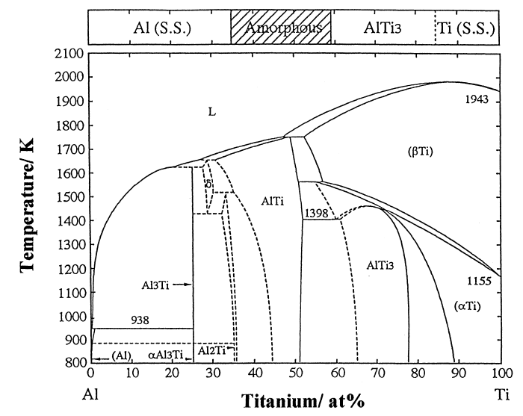
Elemental composition of amorphous phase (EDX results)
Ti, at % | Al, at%
37.6 | 62.4
The difference between r_{Ti} and r_{Al} is only 2,7 %.
However the mixing enthalpy is -30 kJ/mol

Slide 11
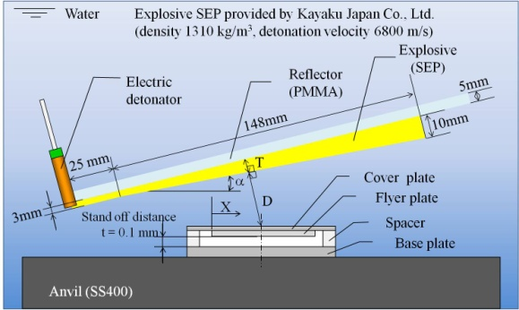
2. Amorphization at underwater welding of Nb foil and stainless steel SUS304 plate*
SUS 304 composition
C | 0.08
Mn | 2.0
Si | 0.75
Cr | 18-20
Ni | 10.5
*experiments were carried out in collaboration with professor K. Hokamoto

Slide 12
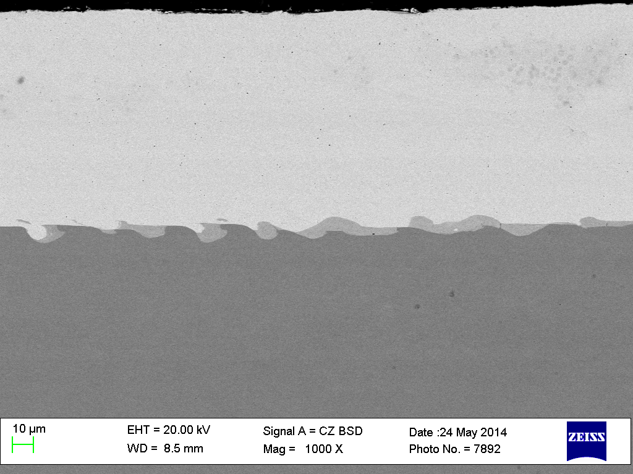
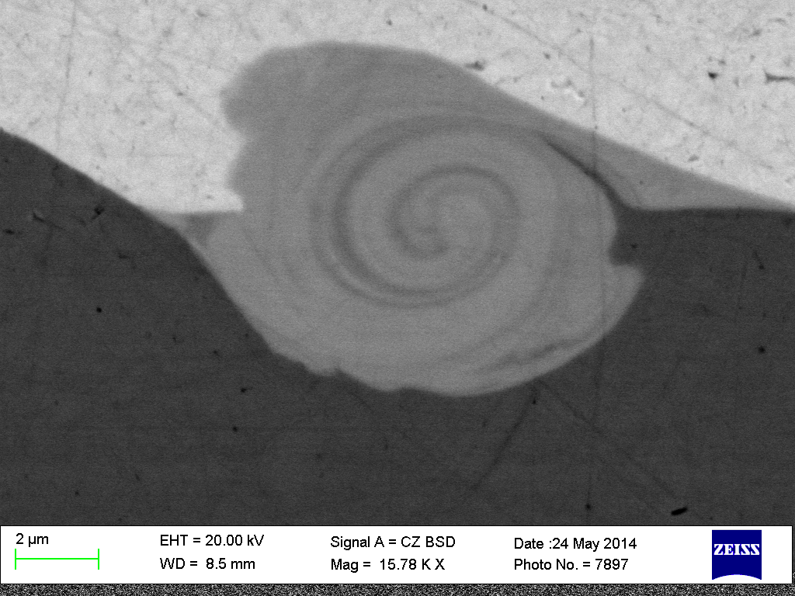
Nb-stainless steel interface

Slide 13
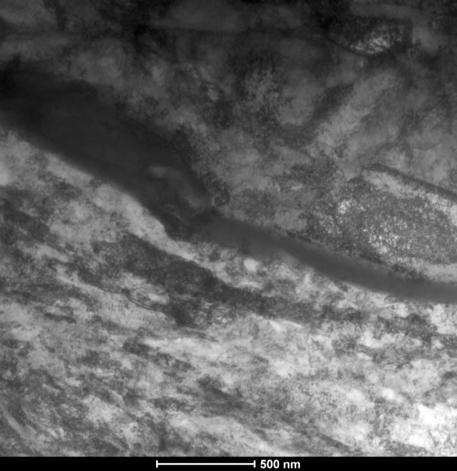
Interface of Nb-SS explosively welded bimetal
Nb
Zone of
mixing
SS

Slide 14
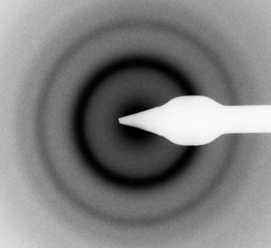
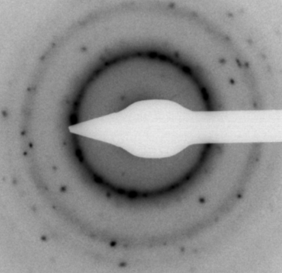
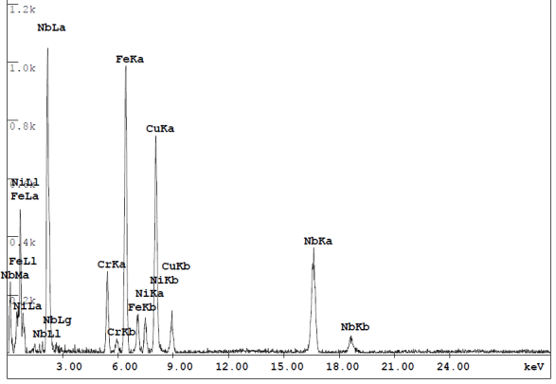
Glassy and partially crystalline parts of the interface
 | Cr | Fe | Ni | Nb
Wt % | 8.6 | 35.7 | 4.8 | 51.0
At % | 11.5 | 44.6 | 5.7 | 38.3

Slide 15
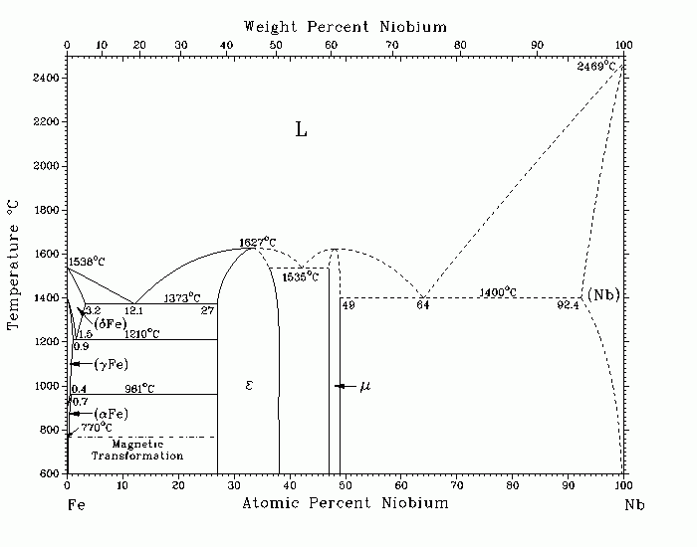
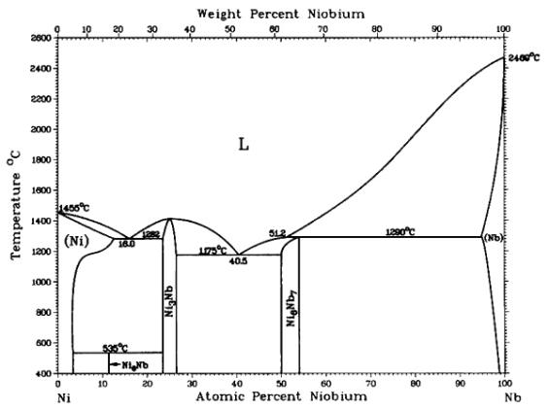
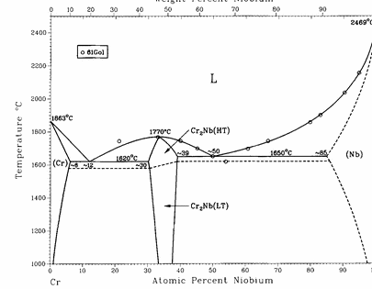
Phase diagram analysis
- Eutectic point
- Expetimental ratio of the elements

Slide 16
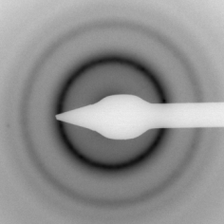
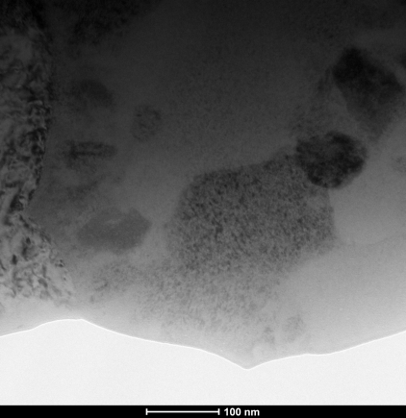
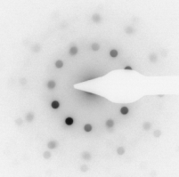
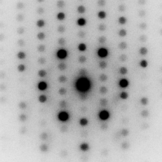
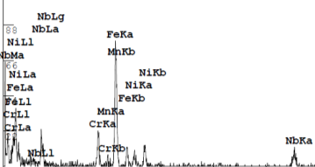
Precipitations in the mixing zone
(12-fold quasicristals?)
 | Cr | Ni | Nb | Mn | Fe
Wt % | 13,4 | 4,9 | 21,8 | 0,7 | Rest
At % | 15,6 | 5,1 | 14,3 | 0,8 | Rest

Slide 17
Atomic radii and enthalpy of mixing analysis
Atomic radii difference
Enthalpy of mixing (kJ/mol)
 | Fe | Ni | Cr | Nb
Fe | - | 0,8% | 2,3% | 15,9%
Ni |  | - | 3,2% | 16,8%
Cr |  |  | - | 13,1%
Nb |  |  |  | -
 | Fe | Ni | Cr | Nb
Fe | - | -2 | -1 | -16
Ni |  | - | -7 | -30
Cr |  |  | - | -7
Nb |  |  |  | -
Correspond to Inoue’s rules
Contradict Inoue’s rules

Slide 18
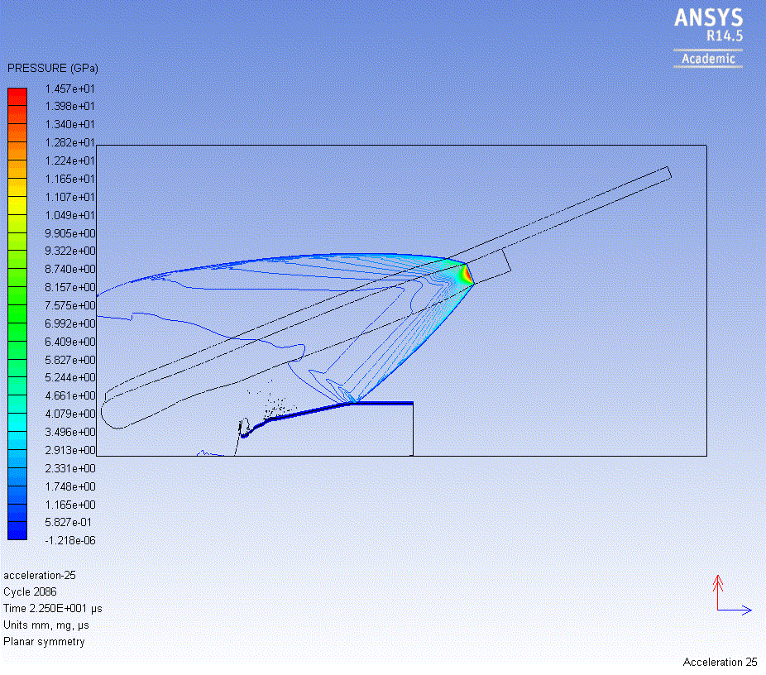
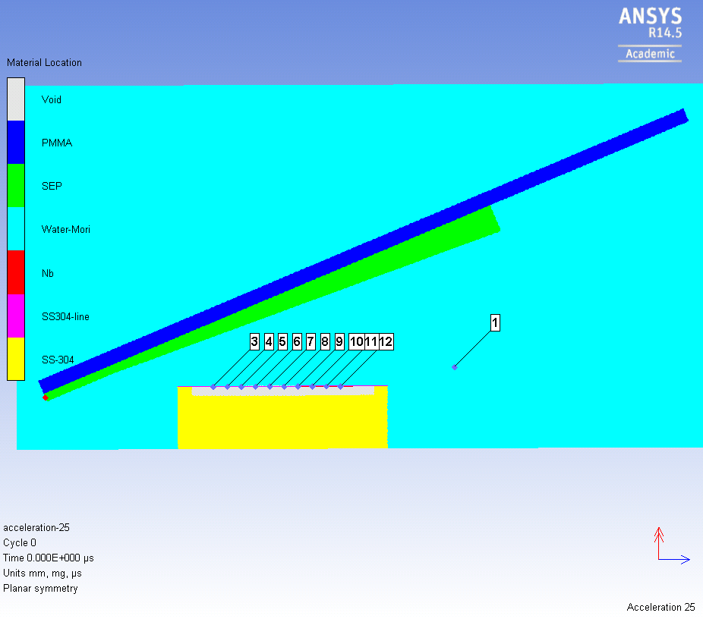
Simulation of Nb and flyer plate acceleration (step 1)*
* In collaboration with prof. I.A. Balagansky

Slide 19
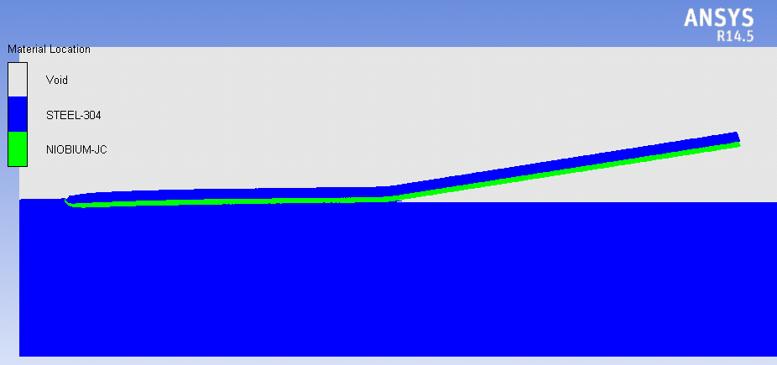
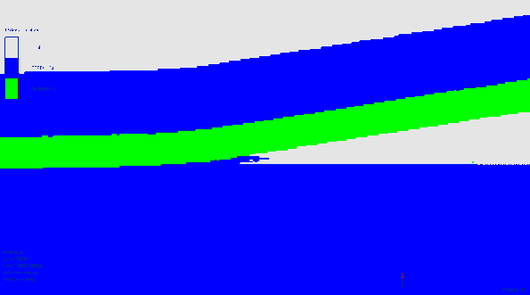
Simulation of Nb and SS collision (step 2)

Slide 20
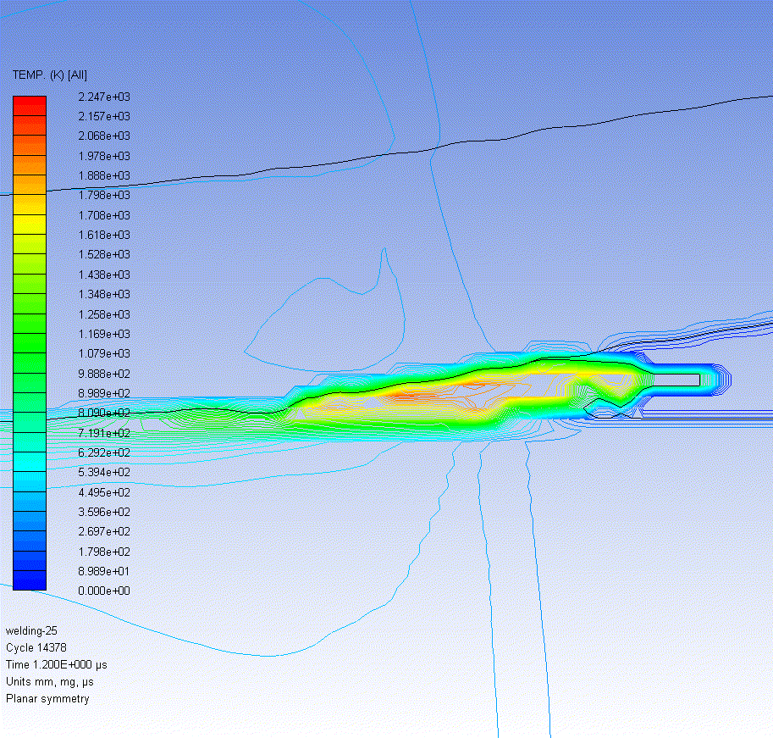
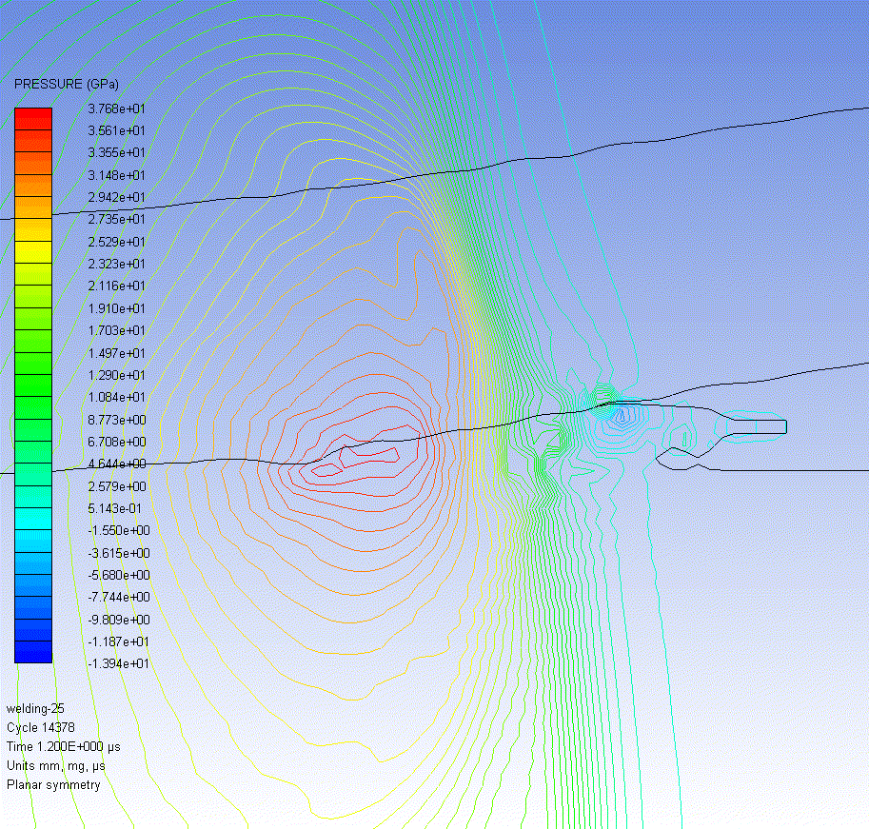
Distribution of pressure and temperature near the contact point
Calculated cooling rate is ~10⁹ K/s

Slide 21
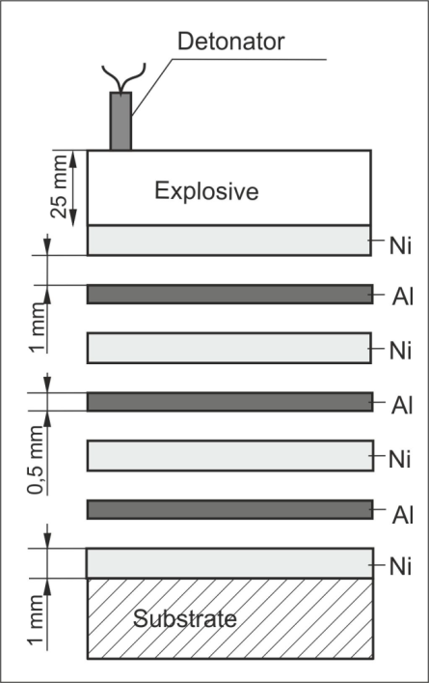
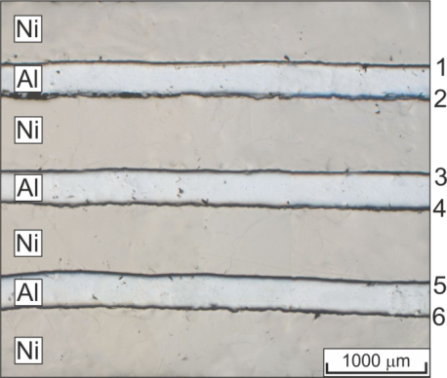
4. Formation of quasicristals at explosive welding of Ni and Al

Slide 22
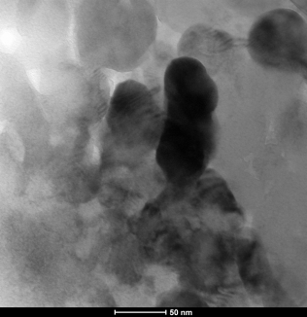
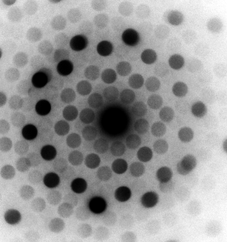
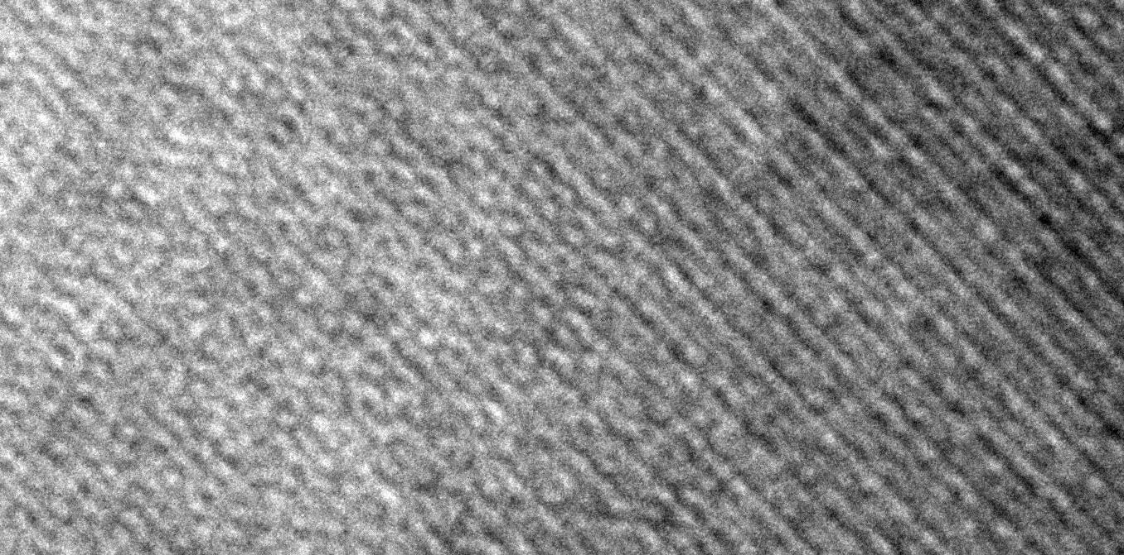

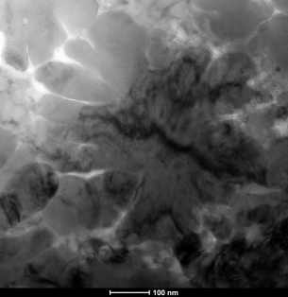
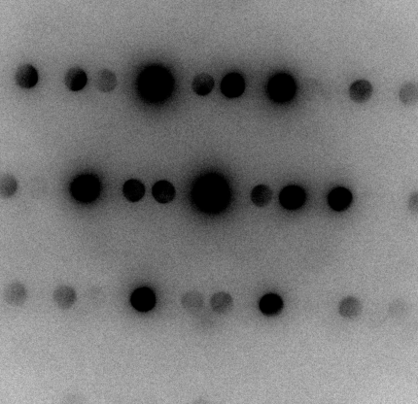
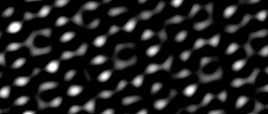
Decagonal quasicrystals in the mixing zone
HRTEM of decagonal phase
HRTEM
processed FFT
HRTEM FFT filtered image indicating local atomic arrangements with 10-fold symmetry

Slide 23
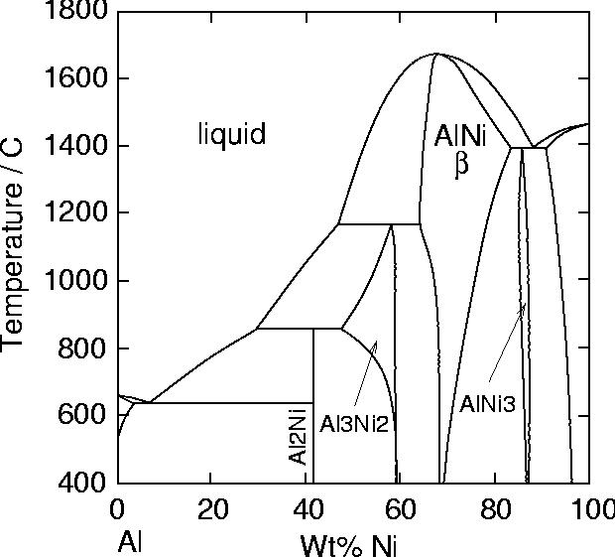
Inoue’s rule analysis for Ni-Al system
The difference between r_{Ni} and r_{Al} is 14,4 %.
The mixing enthalpy is -22 kJ/mol

Slide 24
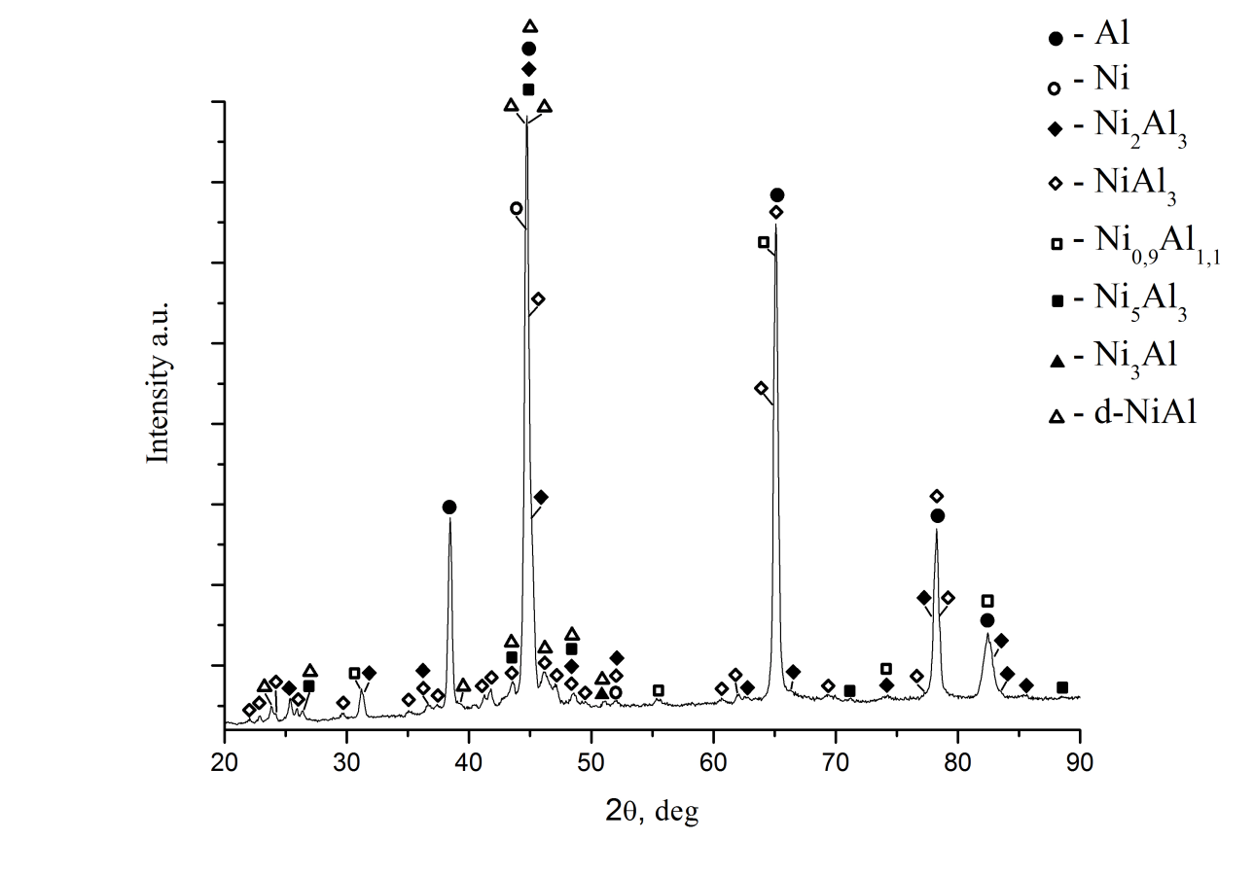
XRD pattern of the interface between Ni and Al plates

Slide 25
Conclusions
Formation of amorphous, quasicrystalline and other metastable phases during explosive welding is highly probable
Due to high cooling rates explosive welding can be considered as one of rapid solidification techniques
However in contrast to rapid solidification techniques (e.g. melt spinning) the local conditions for different zones of melted metal are very nonuniform. Variation of concentration and effect of pressure have to be considered when describing a model of solidification. In the same time this variations open new approach to formation of metastable phases.

Slide 26
Acknowledgements
Ivan Bataev gratefully acknowledge:
professor K. Hokamoto and his group for fruitful collaboration in welding of Nb and stainless steel
professor V.I. Mali and his group for help in experiments with Ti and Al explosive welding and Ni and Al explosive welding
colleagues of Materials Science Department of NSTU for useful discussions

Slide 27
Thank you for your attention!

Slide 28
Reported data on quasicrystals or amorphous phase formation at explosive welding
System | Amorphous/quasicrystals | Reference
Ti-Al | Amourphous | This study
Ni-Al | Quasicrystals | This study
Nb-Stainless steel | Amorphous +QC precipitaions | This study
Ti-Steel (0,09% C) | Amorphous | Chiba et al. Materials Science Forum Vols. 465-466 (2004) pp 465-474 M. Nishida, A. Chiba, Mater. Trans. JIM 36 (11)
Ti-Ni | Amorphous and icosahedral QC | Chiba et al. Materials Science Forum Vols. 465-466 (2004) pp 465-474 M. Nishida, A. Chiba, Mater. Trans. JIM 36 (11)
Zr-Steel | Amorphous | H.Paul et al. EPNM2014 abstract

Slide 29
